Slide 1
Entrepreneurship
Chapter 8 Section 2

Slide 2
The “Five Ps”
People
Product
Place
Price
Promotion

Slide 3
Promotion
Promotion is a type of communication and persuasion we find throughout our daily lives
Part of the Five P’s
Basic principles of Promotion
*Getting Customers*
*Keeping Customers*

Slide 4
Promotion - Getting Customers
AIDA - is a popular communication model used by companies to plan, create, and manage their promotions
A - Attention - grabbing the attention of customers
I - Interest - clearly communicating the features and benefits
D - Desire - what makes your product desirable
A - Action - asking consumers to take action - limited time offer

Slide 5
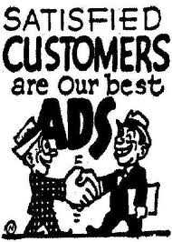
Promotion - Keeping Customers
Promotional messages have to be repeated many times to maximize their effectiveness
To retain customers you must reward them
*Frequent-buyer programs *special price offers *thank you e-mails

Slide 6
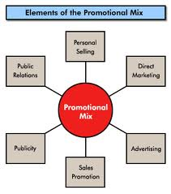
Promotional Mix
Goal of a promotional mix: to build a favorable awareness about your product and or business - to influence people to buy your product
Advertising:
Visual Merchandising
Public Relations (PR)
Publicity
Personal Selling
Sales Promotion

Slide 7
Forms of Advertising
Advertising uses various media or communication channels to send promotional messages to potential customers
Print Advertising
Direct Mail
Radio and Television
Infomercials
Product Placement
Internet
Outdoor Advertising

Slide 8
Visual Merchandising
Attractiveness of display
Eye-catching sign
Selected products at the end of aisles or near check-out lines

Slide 9
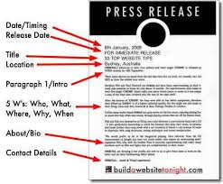
Public Relations and Publicity
Some companies have PR staff and some hire an outside PR company
PR staff use publicity - non-paid advertising
News articles and announcements - press release
Community Events
Contests

Slide 10
Personal Selling and Sales Promotion
Telemarketing - promoting or selling products or services one-to-one over the telephone
Networking- meeting new people though current friends and business contacts

Slide 11
360 Marketing Mix
360 Marketing Mix - company Website, e-mails to existing customers, faxes, direct-mail postcards and catalogs
This approach communicates with your prospects and customers from all directions

Slide 12
Developing a Promotional Plan
Promotional Campaign - is a group of specific promotional activities built around a theme or goal
Stage 1 - creating a business image, educating your target market about features and benefits, awareness
Stage 2 - sales promotions
Stage 3 - strategies to keep customers

Slide 13
Homework
MAGAZINES!!!!!!!!!!

